Slide 1
Computer and data protection techniques and why we need them
Curt Wilson
IT Security Officer & Security Team Lead
Southern Illinois University Carbondale
curtw@siu.edu
618-453-6237

Slide 2
This Presentation & Training
Goal: to teach how to defend Windows computers, users and data against modern threats seen at SIUC
Malicious software (malware) delivery methods
Software patching & use of Secunia OSI tool
User account protections
Sensitive data discovery techniques
Dedicated systems for sensitive transactions

Slide 3
Malware & crimeware threat

Slide 4
Malware & crimeware threat
Malware is MALicious softWARE designed to do the bidding of an attacker or a criminal
Anti-virus and anti-malware companies cannot keep up
Crimeware is financially motivated malware– stealing data, data theft
Crimeware usually attacks the end users computer system (almost always Windows) but can also affect servers
Crimeware has been seen at SIUC and many other .edu, .com, .mil and .gov sites

Slide 5
Why should you care?
Infected systems must be re-installed
Downtime for the user ☹, overtime for you!
Identity theft concerns
Infected systems that contain sensitive data place that data at risk for compromise by criminals
State of IL Personal Information Protection Act requires notification of all affected parties & State of IL General Assembly
For many years SIUC used SSN’s as the primary identifier. Have you cleaned all of your files?
Credit card and bank fraud risks also exist ☹

Slide 7
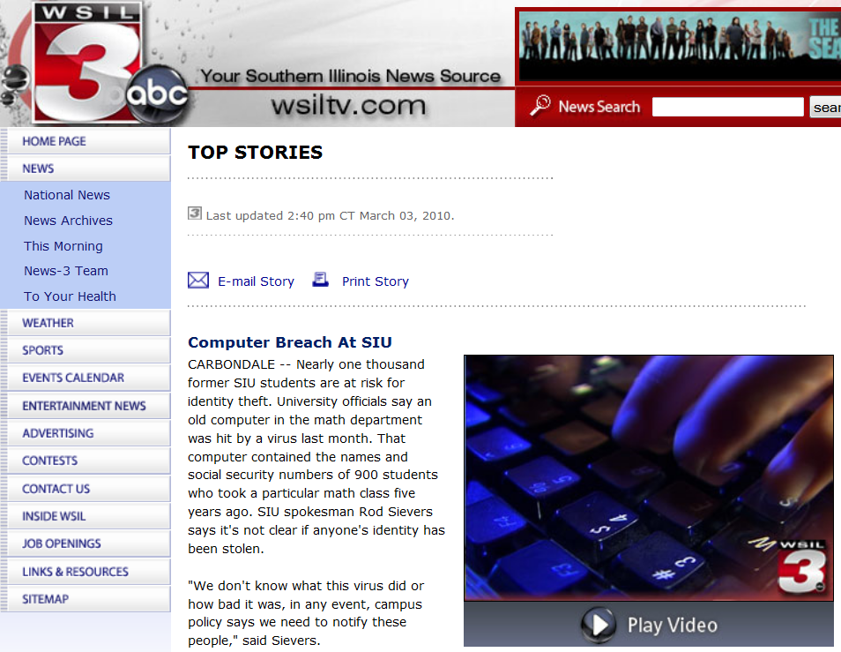

Slide 9
Recent losses due to crimeware
Bullitt County, KY - $415,000 July 2009
Western Beaver School District - $700,000 July 2009
Slack Auto Parts - $75,000 July 2009
FBI (ic3.gov):
As of October 2009, there has been approximately $100 million in attempted losses
On average the FBI is seeing several new victim complaints and cases opened every week

Slide 11
What crimeware does
Typically steals usernames and passwords from victim computers in a stealthy manner. Other data can be stolen as well, such as screenshots and sensitive files.
Criminals typically target financial sites, however a recent attack aimed at automatically stealing Microsoft Office and PDF files from the hard drive
Whatever data can be sold on the black market or monetized is of interest to the criminals

Slide 12
Malware and crimeware functions
Typical malware functionality:
Download and install other malware
Install a keystroke logger (to capture passwords and other sensitive data as they are typed)
Join the computer to a “botnet”
A botnet is a network of compromised computers, under the control of the attacker.
Used to make more money or perform other types of attacks
Can give attackers access to the victim system and other systems that the victim system can access

Slide 13
Crimeware profile – Zeus
Zeus is a crimeware that steals banking information by keystroke logging. Also can steal files and take screenshots and more.
Zeus is spread mainly through drive-by downloads and phishing schemes.
Zeus is estimated to include millions of compromised computers (around 3.6 million in the United States).
A Recent Zeus campaign compromised at least 74,000 computers around the world

Slide 14
Zeus control panel

Slide 15
Crimeware – Torpig
Torpig searches the infected system for credentials, accounts and passwords as well as potentially allowing attackers full access to the computer.
As of November 2008 it has been responsible for stealing the details of about 500,000 online bank accounts and credit and debit cards and is described as "one of the most advanced pieces of crimeware ever created”.
http://en.wikipedia.org/wiki/Torpig

Slide 16
Cyber-Criminals reach out

Slide 17
We ready our response…

Slide 18
Hands-off, cyber-criminals!

Slide 19
Typical Crimeware infection methods
Attackers use trickery (aka “social engineering”) to convince a user to open an attachment or install software that looks like something else.
User visits a website that exploits vulnerable software on their system. The crimeware is then installed as a result of the exploitation. This is often called a “drive-by”.
USB “thumb” drives that were already infected.

Slide 20
Battling Crimeware - trickery
Protection: Educate users who process, transmit or store sensitive information (SSN’s, credit cards, bank account numbers) or who have access to systems that contain such data
It’s important for users to cultivate a general cautiousness, and not to learn to just watch out for specific types of tricks
Copious on-line resources exist. Google for “security awareness” for example
The following slides show some typical tricks

Slide 21
Zeus e-mail with attachment

Slide 22
Zeus Facebook spoof mail with link

Slide 23
Zeus/Zbot FDIC e-mail trickery

Slide 24
Zeus financial e-mail spoof
From: "Automated Clearing House (ACH) Network“ <message-94953038943781trans_id@nacha.org> Subject: Unauthorized ACH Transaction
Dear bank account holder, The ACH transaction, recently initiated from your bank account, was rejected by the Electronic Payments Association. Please review the transaction report by clicking the link below:
Unauthorized ACH Transaction Report
------------------------------------------------------------------ Copyright ©2009 by NACHA - The Electronic Payments Association

Slide 25
Zeus financial e-mail spoof
The last slide is an example of an attack that uses both “social engineering” (trickery) and software exploitation via a “drive-by” (discussed later)
When a user clicks on the link, the destination website attempts to exploit their computer to install crimeware.
More on this technique and it’s defenses later.

Slide 26
Don’t be fooled!
Be on the lookout for an emotional reaction from an e-mail message that attempts to convince the reader to take some sort of action
Free stuff! Click here!
Locked out of account unless you click here!
Bank failure! Click here!
You have/owe money! Click here or else!
Income tax return ready! Click here!
You are under investigation! Click here!
OMG is this you in this picture? Click here!
I can’t open this document, can you? Click here!
You are infected with viruses! Click here!

Slide 27
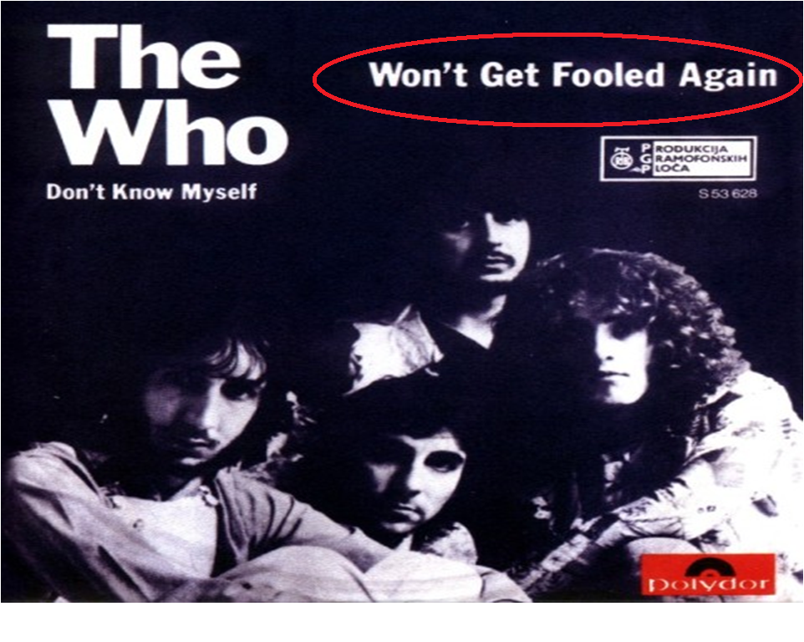

Slide 28
Detecting crimeware
Anti-virus still a must-have
Do not count on it however. It fails frequently.
Use AV instead as a notification system that there is a problem requiring further attention.
IT Security monitoring systems
Detect crimeware talking over the network
We then contact LAN Admin & contain the issue
Unusual system activity

Slide 29
Cleaning up after crimeware
Change *ALL* passwords that ever passed through, or were stored on the infected system right away
Start with any financial credentials
Don’t do this from the compromised system!
Take the infected system off of the network ASAP
Interview the users and attempt to find out what happened. Coordinate with IT Security.

Slide 30
Cleaning up after crimeware
Follow SIUC policy and state law regarding any potential data breach and victim & general assembly notification
Malware on a credit card processing system = data breach and PCI violation! Bad news.
Malware on a system storing names & SSN’s = data breach. Bad news.
See State of Illinois “Personal Information Protection Act” and PCI rules
http://policies.siuc.edu/policies/prsnlinfoprotectionact.htm

Slide 31
Cleaning up after crimeware
Do not attempt to “clean” the system with a cleaning tool. They fail many times and can create a false sense of security. Re-install the system from scratch.
We know this can be painful ☹ but it’s necessary 😐
Follow the guidance of SIUC’s IT Security Team when dealing with infection incidents.
Notify IT Security if you wish to attempt to prosecute. IT Security will coordinate with law enforcement.

Slide 32
Targeted attacks – spear phishing

Slide 33
Targeted attacks (spear phishing)
The previous example e-mails were sent out in bulk and appear to be generic, commodity level attacks
Targeted attacks (aka “spear phishing)
attacker researches target and plans attack
Much harder to protect against
Targets of high value are at higher risk
Financial processing – bank accounts, credit cards, etc.
Espionage – corporate and nation-state
What users in your areas are juicy targets?

Slide 34
Targeted attack examples
The following screenshots show “bait files” e-mailed to targets. A good bait file is something that the target would be specifically interested in.
Bob likes fishing. Ted is interested in investment. Alice is a venture capitalist.
These bait files were either booby-trapped or part of a larger attack that gave the attackers full access
The bait files themselves could have been created in a way to compromise the computer
Or the bait files may have been a distraction

Slide 35
Target: energy sector

Slide 36
Target: banking sector

Slide 37
Target: foreign relations

Slide 38
Dealing with targeted attacks
Targeted attacks often use less obvious trickery and may include attacks on new security holes that are not yet known by the vendor (such as Adobe, Microsoft)
Difficult to defend against, very effective for the criminals (see “Aurora” - Google, Adobe, etc late 2009/ early 2010)
Attacking organization has invested resources in the attack, hoping for a return on investment
Work with IT Security if you suspect a targeted attack

Slide 39
Drive-by download attack

Slide 40
Drive-by download attack
A drive-by download, or drive-by infection happens when user visits malicious content which then infects their vulnerable computer with malware
Contents displayed or launched by web browser (or other app – e-mail, instant messenger, etc) creates a risk
PDF documents, Java, Flash, QuickTime, Office documents, etc.
Reduce browser integration to create less attack surface. Less convenient for user, but provides better protection

Slide 41
Examples of drive-by downloads
User receives an e-mail message that contains a link
That link points to malicious contents on a web site
The malicious contents are specially designed to exploit some aspect of the users computer system
Unpatched versions of Adobe Acrobat Reader, Java, Adobe Flash are very popular targets
User is surfing the web, such as Facebook
Comes across a malicious link that’s automatically loaded by their web browser

Slide 42
Examples of drive-by downloads
User searches Google for recent high-profile media event (example: Haiti earthquake Jan 2010)
Some links returned by Google are trap sites built by attackers who want to take advantage of news coverage
Google is actively working on this problem with site blacklisting and other scanning technologies
Any other search engine is also subject to this
Attackers seed the search engines with evil sites
Malicious ads (Java, Flash content) loaded into ad networks such as Double-click

Slide 43
Protecting against drive-bys
Most drive-by’s take advantage of the fact that many people do not update their computers operating system and third-party software (Flash, Java, Acrobat Reader, etc) often enough to close security holes.
PATCHING will stop almost all drive-by infections
This is the most important point
Website reputation tools can help identity malicious sites to reduce clicking on malicious links

Slide 44
Stopping drive-by infections
Keep the operating system and all third-party applications up-to-date. *Most important point*
DEMO: Use web of Trust (WOT) and/or McAfee Site Advisor browser plugins to help distinguish good sites from bad
http://www.mywot.com/
http://www.siteadvisor.com/
Consider reducing the amount of rendered content from within the web browser
Use different web browsers for sensitive and non-sensitive functions
Isolate systems that must process/store/transmit sensitive data – no internet and no thumb drives

Slide 45
Secunia Online Software Inspector http://secunia.com/vulnerability_scanning/online/

Slide 46
Secunia Online Software Inspector http://secunia.com/vulnerability_scanning/online/
OSI will check the most common applications and will notify you when applications are missing security patches.
It does not check everything, but checks all of the important commonly installed applications that are often targeted by cyber-criminals
Adobe Acrobat Reader
Adobe Flash
Quicktime
Etc.

Slide 47
Secunia Online Software Inspector http://secunia.com/vulnerability_scanning/online/

Slide 48
Secunia Online Software Inspector http://secunia.com/vulnerability_scanning/online/
The OSI is a security update notification tool, not a patch management tool
User/administrator still has to manually handle uninstalling and re-installing applications
Adds to technical support costs
Some applications can be more difficult to update
Adobe Flash is known for this
Attackers love it when apps are difficult to update because then people don’t update and become easy prey

Slide 49
Secunia Personal Software Inspector http://secunia.com/vulnerability_scanning/personal/
The Personal Software Inspector is free, but licensed only for personal use – SIUC use is not allowed.
Great for your home computers
Home computers can be great targets for cyber-criminals because they are often not managed with the same operational discipline
One VPN connection into a sensitive network from a compromised home PC can result in bad guys getting in

Slide 51
Secunia Personal Software Inspector http://secunia.com/vulnerability_scanning/personal/
This shows the Photoshop, Adobe Reader version 8.x, and Apple QuickTime are vulnerable and that the risk is very high. This also shows the Adobe SVG Viewer version 3.x is vulnerable, but that the risk is rather low. Focus on remediating the higher-risk vulnerabilities first.

Slide 52
Secunia Corporate Software Inspector http://secunia.com/vulnerability_scanning/corporate/
Secunia offers a corporate version of it’s software inspection tool that can be deployed across a network and provides centralized management.
Based on my evaluation, the CSI is similar to the PSI
I do not work for and have no financial interest in Secunia – I just want you to get the message that you must patch security holes!

Slide 53
DEMO – OSI & Patching processes
Using the Secunia Online Software Inspector to detect missing operating system and third party patches
Patching Windows XP SP3
Automatic Updates enabled
Use of Microsoft Update
Patching 3rd party applications
Older apps can be more difficult to update
May require manual file remove (such as old versions of Flash)
Safe bet when in doubt is to uninstall old version then install new version(may require reboot in some cases)
Run Secunia OSI again after patching is complete

Slide 54
Software update is not fool-proof
Even when all software is up-to-date, attackers can still compromise systems through other methods
Trickery (as previously discussed)
“Zero day” attacks
Attacker targets a vulnerability that has not yet been patched
Layered defenses (aka “Defense in Depth”) help
Zero day works best for targeted, high-value attacks

Slide 55
Account and system isolation
Two main types of accounts exist in a Windows system
Administrator or Power-User account
Can do anything on the computer, “super user”
Limited/Restricted User account (Vista/7: Standard User)
Users that process/store/transmit sensitive data should do so with a limited user account. A limited user account will protect against many malware attacks, but not all
Vista and Windows 7
Ensure User Account Control is enabled
Prompts for riskier actions

Slide 56
Account and system isolation not fool-proof
The Zeus crimeware, previously mentioned, can still attack a computer when a user is using a limited account
Attackers adapting to countermeasures
Modern attackers often want *DATA* and may not care about admin rights
Limited user account can still contain much juicy data!

Slide 57
DEMO – finding sensitive data with the DataFind toolkit
ftp.siu.edu/datafind
Much data on a hard drive looks like an SSN.
False alarms are to be expected
Must look at *context* of the data
Folder names
File names
How the system is/was used
Other free toolkits exist if you don’t like DataFind
Cornell Spider http://itso.iu.edu/Cornell_Spider
Find the sensitive data and purge it

Slide 58
Using the DataFind toolkit
DataFind provides an easy-to-use browser to view the report and provides easy clean-up
Report file: c:\DataFind\ssn_scan\Find_SSNs.html
Master directory: C:\DataFind
DataFind instructions walk through every step of the process.
ftp://ftp.siu.edu/datafind/DataFindDocumentation.pdf

Slide 59
Easy Office 2007 encryption
Encrypting data that must be maintained will be a topic of another session, but for starters -
Use Microsoft Office 2007 (site licensed)
Office button -> Prepare -> Encrypt Document
Enter a passphrase
Store the passphrase safely (with supervisor, in a safe, etc)
Save the document
Ensure that whoever needs to open the document has Office 2007 and the passphrase
File -> Open -> enter passphrase

Slide 60
Account and system isolation
Another thing to consider is using isolated systems to process sensitive data
Idea 1: No Internet connectivity at all
Connectivity only to the sensitive networks and sensitive resources required to perform business duties
Idea 2: Limited Internet connectivity, perhaps filtered through a list of specifically allowed websites
Can still be risky, idea 1 is better
Idea 3: Use different web browsers for sensitive and non-sensitive tasks
Still risky, idea 1 is better

Slide 61
Account and system isolation
Policies
Consider banning personal internet use on systems that store/process/transmit sensitive data
Must have means to enforce this if you make such a policy, otherwise it has no teeth
Consider banning the use of USB thumb drives or CD’s/DVD’s that are not approved by authorized support technicians
End users think nothing of plugging in USB drives anywhere or even plugging in a USB drive they find laying around

Slide 62
Wrap-up
Attackers are financially motivated and are doing well
By knowing their techniques, we can better defend
Defenders must strive to increase their threat awareness and be able to dynamically adapt
Protect the most important assets first

Slide 63
References
Neustar: The Irretrievable Losses of Malware-Enabled ACH and Wire Fraud
http://www.neustar.biz/pressroom/whitepapers/ACH_White_Paper.pdf
Compromise Of User's Online Banking Credentials Targets Commercial Bank Accounts
http://www.ic3.gov/media/2009/091103-1.aspx
Fraudulent Automated Clearing House (ACH) Transfers Connected to Malware and Work-at-Home Scams
http://www.fbi.gov/pressrel/pressrel09/ach_110309.htm

Slide 64
Questions/Comments/Discussion
curtw@siu.edu or phone to discuss any of these items in more depth
I wish you ongoing success in protecting all of your computer systems, but especially those that handle any sort of sensitive data

