Slide 1
Computer and data protection techniques and why we need them
Curt Wilson
IT Security Officer & Security Team Lead
Southern Illinois University Carbondale
curtw@siu.edu
618-453-6237

Slide 2
This Presentation & Training
Goal: to teach how to defend Windows computers, users and data against modern threats seen at SIUC
Malicious software (malware) delivery methods
Software patching & use of Secunia OSI tool
User account protections
Sensitive data discovery techniques
Dedicated systems for sensitive transactions

Slide 3
Malware & crimeware threat

Slide 4
Malware & crimeware threat
Malware is MALicious softWARE designed to do the bidding of an attacker or a criminal
Crimeware is financially motivated malware– stealing data, data theft

Slide 5
Why should you care?
Infected systems MUST be re-installed
Identity theft concerns
State of IL Personal Information Protection Act requires notification of all affected parties & State of IL General Assembly

Slide 7
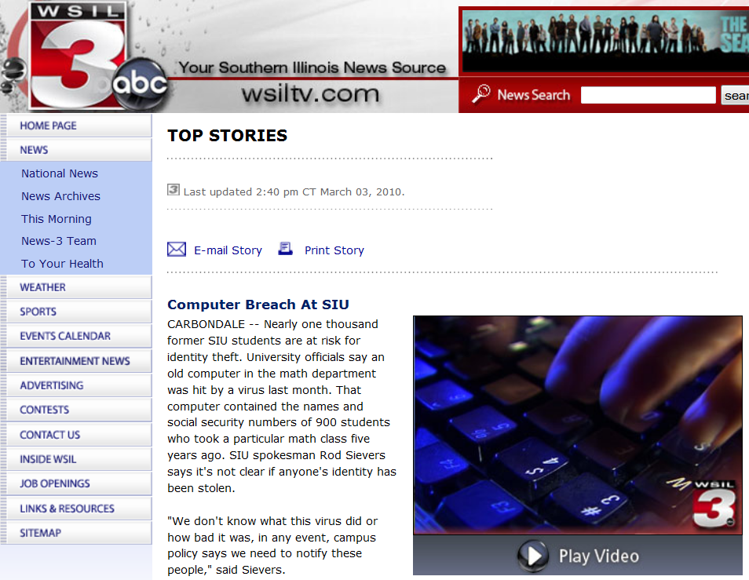

Slide 9
Recent losses due to crimeware
Bullitt County, KY - $415,000 July 2009
Western Beaver School District - $700,000 July 2009
Slack Auto Parts - $75,000 July 2009
FBI (ic3.gov):
As of October 2009, there has been approximately $100 million in attempted losses
On average the FBI is seeing several new victim complaints and cases opened every week

Slide 11
What crimeware does
Typically steals
Usernames
Passwords
Screenshots and sensitive files
Very Stealthy
Recent attack aimed at automatically stealing Microsoft Office and PDF files
Whatever has black market value

Slide 12
Malware and crimeware functions
Typical malware functionality:
Downloads other malware
Installs a keystroke logger
Join the computer to a “botnet”
Can give attackers access to the victim system and other systems that the victim system can access

Slide 13
Crimeware profile – Zeus
Zeus is a crimeware that steals….
BANKING INFORMATION!
And more…

Slide 14
Crimeware – Torpig
Torpig is a crimeware that steals…
ACCOUNTS and PASSWORDS!
And more…
Responsible for stealing 500,000 online bank accounts and credit and debit cards

Slide 15
Cyber-Criminals reach out

Slide 16
We ready our response…

Slide 17
Hands-off, cyber-criminals!

Slide 18
Typical Crimeware infection methods
Social Engineering – a.k.a. Trickery
The Drive-By – Simply visit a website…
USB “thumb” drives that were already infected.

Slide 19
Battling Crimeware - trickery
Educate, Educate, Educate
Copious on-line resources exist
Google “security awareness”

Slide 20
Zeus e-mail with attachment

Slide 21
Zeus Facebook spoof mail with link

Slide 22
Zeus/Zbot FDIC e-mail trickery

Slide 23
Zeus financial e-mail spoof
From: "Automated Clearing House (ACH) Network“ <message-94953038943781trans_id@nacha.org> Subject: Unauthorized ACH Transaction
Dear bank account holder, The ACH transaction, recently initiated from your bank account, was rejected by the Electronic Payments Association. Please review the transaction report by clicking the link below:
Unauthorized ACH Transaction Report
------------------------------------------------------------------ Copyright ©2009 by NACHA - The Electronic Payments Association

Slide 24
Don’t be fooled!
Be on the lookout for an emotional reaction from an e-mail message that attempts to convince the reader to take some sort of action
Free stuff! Click here!
Locked out of account unless you click here!
Bank failure! Click here!
You have/owe money! Click here or else!
Income tax return ready! Click here!
You are under investigation! Click here!
OMG is this you in this picture? Click here!
I can’t open this document, can you? Click here!
You are infected with viruses! Click here!

Slide 25
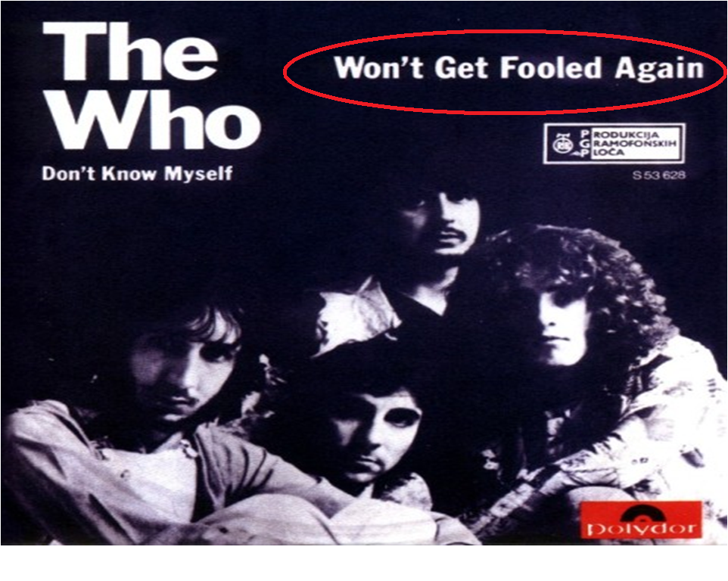

Slide 26
Detecting crimeware
Anti-virus still a must-have
AV is far from perfect
Use AV as a notification tool
IT Security monitoring systems
Detect crimeware talking over the network
We then contact LAN Admin & contain the issue
Unusual system activity

Slide 27
Cleaning up after crimeware
Change *ALL* passwords immediately
Start with any financial credentials
Don’t do this from the compromised system!
Remove infected system from the network ASAP
Interview the users and attempt to find out what happened. Coordinate with IT Security.

Slide 28
Cleaning up after crimeware
Follow SIUC policy…
Malware on a credit card processing system = data breach and PCI violation! Bad news.
Malware on a system storing names & SSN’s = data breach. Bad news.
See State of Illinois “Personal Information Protection Act” and PCI rules
http://policies.siuc.edu/policies/prsnlinfoprotectionact.htm

Slide 29
Cleaning up after crimeware
Do not “clean”!
Format and Re-Install
We know this can be painful ☹ but it’s necessary 😐
Notify IT Security who will coordinate with law enforcement

Slide 30
Targeted attacks – spear phishing

Slide 31
Targeted attacks (spear phishing)
Targeted attacks (aka “spear phishing)
Attacker researches target and plans attack
Targets of high value are at higher risk
Financial processing – bank accounts, credit cards, etc.
Espionage – corporate and nation-state
What users in your areas are juicy targets?

Slide 32
Targeted attack examples
“Bait files”
Bob likes fishing
Ted is interested in investments
Alice is a venture capitalist.

Slide 33
Target: energy sector

Slide 34
Target: banking sector

Slide 35
Target: foreign relations

Slide 36
Dealing with targeted attacks
Targeted attacks are less obvious trickery
Difficult to defend against
Attackers invest resources, hoping for a return on investment
Work with IT Security if you suspect a targeted attack

Slide 37
Drive-by download attack

Slide 38
Drive-by download attack
A drive-by download, or drive-by infection happens when user visits malicious content which then infects their vulnerable computer with malware
Contents displayed or launched by web browser (or other app – e-mail, instant messenger, etc) creates a risk
PDF documents, Java, Flash, QuickTime, Office documents, etc.
Reduce browser integration to create less attack surface. Less convenient for user, but provides better protection

Slide 39
Examples of drive-by downloads
User receives an e-mail with link
Link points to a malicious web site
The website is specially designed to exploit a system weakness
Unpatched versions of Adobe Acrobat Reader, Java, Adobe Flash are very popular targets
User is surfing the web, such as Facebook
Comes across a malicious link that’s AUTOMATICALLY loaded by their web browser

Slide 40
Examples of drive-by downloads
User searches Google for recent high-profile media event (example: Haiti earthquake Jan 2010)
Some links returned by Google are trap sites
Google is actively working on this problem
Not just a Google
Attackers seed the search engines with evil sites
Malicious ads (Java, Flash content) loaded into ad networks such as Double-click

Slide 41
Protecting against drive-bys
Patch, Patch, Patch those 3rd Party Apps!
Flash
Java
Acrobat Reader
Everything
PATCHING will stop almost all drive-by infections
This is the most important point
Website reputation tools can help identity malicious sites to reduce clicking on malicious links

Slide 42
Stopping drive-by infections
Patch the OS!
Patch all 3rd Party Apps! *Most important point*
DEMO: Use web of Trust (WOT) and/or McAfee Site Advisor browser plugins to help distinguish good sites from bad
http://www.mywot.com/
http://www.siteadvisor.com/
Consider reducing the amount of rendered content from within the web browser
Use different web browsers for sensitive and non-sensitive functions
Isolate systems that must process/store/transmit sensitive data – no internet and no thumb drives

Slide 43
Secunia Personal Software Inspector http://secunia.com/vulnerability_scanning/personal/
The OSI – Online Software Inspector is
Free
Available to anyone
The PSI - Personal Software Inspector is
Free
Licensed only for personal use
The CSI – Corporate Software Inspector
Must be purchased

Slide 44
Secunia Online Software Inspector http://secunia.com/vulnerability_scanning/online/
OSI will…
Check the most common applications
Notify you
OSI will NOT
Check everything
Will not patch for you

Slide 45
Secunia Online Software Inspector http://secunia.com/vulnerability_scanning/online/

Slide 46
Secunia Online Software Inspector http://secunia.com/vulnerability_scanning/online/

Slide 48
Secunia Personal Software Inspector http://secunia.com/vulnerability_scanning/personal/
This shows the Photoshop, Adobe Reader version 8.x, and Apple QuickTime are vulnerable and that the risk is very high. This also shows the Adobe SVG Viewer version 3.x is vulnerable, but that the risk is rather low. Focus on remediating the higher-risk vulnerabilities first.

Slide 49
DEMO – OSI & Patching processes
Using the Secunia Online Software Inspector to detect missing operating system and third party patches
Patching Windows XP SP3
Automatic Updates enabled
Use of Microsoft Update
Patching 3rd party applications
Older apps can be more difficult to update
May require manual file remove (such as old versions of Flash)
Safe bet when in doubt is to uninstall old version then install new version(may require reboot in some cases)
Run Secunia OSI again after patching is complete

Slide 50
Software update is not fool-proof
Even when all software is up-to-date, attackers can still compromise systems through other methods
Trickery (as previously discussed)
“Zero day” attacks
Attacker targets a vulnerability that has not yet been patched
Layered defenses (aka “Defense in Depth”) help
Zero day works best for targeted, high-value attacks

Slide 51
Account and system isolation
Two main types of accounts exist in a Windows system
Administrator or Power-User account
Limited/Restricted User account (Vista/7: Standard User)
Users that process/store/transmit sensitive data should do so with a limited user account. A limited user account will protect against many malware attacks, but not all
Vista and Windows 7
Ensure User Account Control is enabled
Prompts for riskier actions

Slide 52
Account and system isolation not fool-proof
The Zeus crimeware can still attack a computer when a user is using a limited account
Attackers adapting to countermeasures
Modern attackers often want *DATA* and may not care about admin rights
Limited user account can still contain much juicy data!

Slide 53
Finding sensitive data with the DataFind toolkit
ftp.siu.edu/datafind
Much data on a hard drive looks like an SSN.
False positive
Must look at *context* of the data
Folder names
File names
How the system is/was used
Other free toolkits exist if you don’t like DataFind
Cornell Spider http://itso.iu.edu/Cornell_Spider
Find the sensitive data and purge it

Slide 54
Using the DataFind toolkit - DEMO
DataFind provides
Easy-to-use browser to view the report
Provides easy clean-up
DataFind instructions walk through every step of the process.
ftp://ftp.siu.edu/datafind/DataFindDocumentation.pdf

Slide 55
Dealing with sensitive data – a note on encryption
Find the sensitive data and PURGE IT!
Encrypt this data if you must keep it
Encryption will be a future workshop topic
http://pki.siu.edu/encrypting_files.html

Slide 56
Fast & easy Office 2007 encryption
IF THE SENSITIVE DATA IS NOT NEEDED,
DELETE IT!
IF THE SENSITIVE DATA IS NEEDED,
ENCRYPT IT!
Office 2007 has easy to use encryption built-in

Slide 57
Account and system isolation
Isolate systems containing sensitive data
Idea 1: No Internet connectivity at all
Connectivity only to what is absolutely necessary
HIGHLY suggested for banking/financial systems!
Idea 2: Limited Internet connectivity,
Can still be risky, idea 1 is better
Idea 3: Use different web browsers for sensitive and non-sensitive tasks
Still risky, idea 1 is better

Slide 58
Account and system isolation
Policies
Consider banning personal internet use on systems that store/process/transmit sensitive data
Consider banning the use of USB thumb drives or CD’s/DVD’s that are not approved by authorized support technicians

Slide 59
Wrap-up
Attackers are financially motivated and are doing well
By knowing their techniques, we can better defend
Defenders must strive to increase their threat awareness and be able to dynamically adapt
Protect the most important assets first

Slide 60
Wrap-up
Patch the OS
Patch the 3rd Party Apps
Antivirus
Firewall on
Sensitive Data – Scan then Purge or Encrypt
Educate your users

Slide 61
References
Neustar: The Irretrievable Losses of Malware-Enabled ACH and Wire Fraud
http://www.neustar.biz/pressroom/whitepapers/ACH_White_Paper.pdf
Compromise Of User's Online Banking Credentials Targets Commercial Bank Accounts
http://www.ic3.gov/media/2009/091103-1.aspx
Fraudulent Automated Clearing House (ACH) Transfers Connected to Malware and Work-at-Home Scams
http://www.fbi.gov/pressrel/pressrel09/ach_110309.htm

Slide 62
Questions/Comments/Discussion
curtw@siu.edu or phone to discuss any of these items in more depth
I wish you ongoing success in protecting all of your computer systems, but especially those that handle any sort of sensitive data

